Slide 1
PHP - OOP
HASAN
=|Be yourself!|=

Slide 2
OOP STANDS FOR
Object Oriented Programming

Slide 3
Procedural programming is
about writing procedures
or functions that
perform operations
on the data.
object-oriented
programming is about
creating objects that contain
both data and functions.
Difference between

Slide 4

Advantages of OOP
Faster and easier
Clear structure
DRY Concept
Reusable

Slide 5
OOP
Class
Object
Properties
Method
Instance
new

Slide 6
CLASS
Template / sebuah kerangka
dari suatu object.
Mendefinisikan Object
Menyimpan Property dan Method

Slide 7
Class
Property
Method
Variable
Function

Slide 8


Yes, of course! You can!
May I see how to create a class?

Slide 9

Class namaClass{
$property;
method(){
//code goes here
}
}
Class keyword
A
Curly Bracket {}
A
Curly Bracket {}
Property & Method

Slide 10




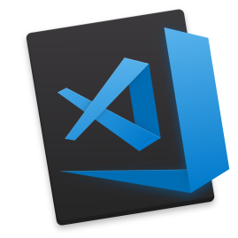
Time to code

Slide 11




saweria.co/sobatngodingpemula
DANA
081315269591
OVO
081315269591
Buy me a coffee?

Slide 12
THANK YOU

